Slide 1
A1 Chemistry
Balancing equations

Slide 2
Learning Intentions
chemical reactions can be represented by chemical equations; balanced chemical equations indicate the relative numbers of particles (atoms, molecules or ions) that are involved in the reaction

Slide 3
Success Criteria
Write balanced ionic equations, given reactants’ and products’ names.
Identify spectator ions.

Slide 4
Key words
Law of Conservation of Matter
coefficient
Reactant
aqueous
product
weak/strong ionisation/dissociation
spectator ion

Slide 5
Chemical equations
reactants → products
Law of Conservation of Matter explains that atoms are not created or destroyed, but rearranged, when substances undergo a chemical reaction.
The number of each type of atoms in the reactants are the same as in the products.
Coefficients show the ratio of each substance in a reaction (of actual numbers of atoms, molecules or ions AND of moles of atoms, molecules or ions)

Slide 6
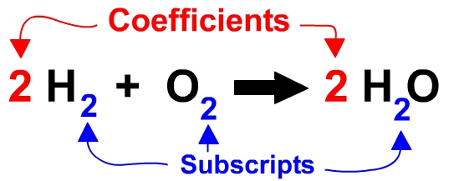

Slide 7
Tips
Balance largest formulae first.
Balance any element that appears more than once on either side last
Treat polyatomic ions that remain intact as a single unit to balance
Balance C first, O last in combustion reactions
H₂SO₄ _{(aq)} + KOH _{(aq)} → K₂SO_{4 (aq)} + H₂O_{(l)}

Slide 8
Ionic Equations
In order to accurately represent a reaction, an equation should only include reacting species
Ionic compounds which are soluble dissociate (split apart into individual ions) when dissolved in water.
For many reactions, only one type of ions in an ionic compound undergoes a reaction; the other ion is still present, unchanged in the reactants.
These ions are referred to as spectator ions, and are omitted in an ionic equation.

Slide 9
Which ions dissociate?
Soluble ionic salts, ie those containing metals and non-metals and are aqueous in state
Aqueous compounds are indicated as (aq) in an equation.

Slide 10
Some molecules may ionise
Some molecular covalent substances turn into ions when dissolved in water.
Compounds which fully ionise are referred to as ‘strong’ ionisers, most of them are acids.
Include HCl, H₂SO₄ and HNO₃

Slide 11




Writing ionic equations
Write the equation, including states
Ionise strong molecular or dissociate soluble ionic compounds
Get rid of ‘spectator ions’
Balance what’s left; atoms and charges must balance
HCl (aq)
+
Zn (s)
+
→
ZnCl₂ (aq)
H₂ (g)
2
Zn⁺² (aq)
H₂ (g)
H⁺ (aq)
Cl⁻ (aq)
Cl⁻ (aq)

Slide 12
Ions or not?
NaCl (aq)
NaCl (s)
H₂SO₄ (aq)
CH₃COOH (aq)
CO₂ (g)
MgCl₂ (aq)
AgCl (s)
H₂O (l)
Na⁺ (aq) + Cl⁻ (aq)
H⁺ (aq) + SO₄²⁻ (aq)
Mg²⁺ (aq) + Cl⁻ (aq)

